Slide 1

Fleet Monitoring System
Sdmay18-18
http://sdmay18-18.sd.ece.iastate.edu/
Client/Advisor: Lotfi Ben-Othmane
Group Members: Venecia Alvarez, Kendall Berner, Matthew Fuhrmann, William Fuhrmann,
Anthony Guss, Tyler Hartsock

Slide 2
Problem Statement
Problem:
Companies have many vehicles
Vehicle fleets are inefficient and costly
Solution:
Allow a fleet manager to see real time data of vehicles
Allow a fleet manager to see periodic reports about each vehicle and each driver

Slide 3
Functional Requirements
The product shall:
Gather data from a vehicle’s ODB-II port
Transmit data from the vehicle to the server
Process raw data from the vehicle on the server
Record vehicle data into a database
Display a map with a location of all vehicles in the fleet
Display historical data for a certain vehicle

Slide 4
Non-Functional Requirements
The product shall:
Be used by vehicles at any time and location
Utilize Google Cloud services
Only allow managers to view fleet data on the dashboard
Have the server side code made in Node.js
Use AngularJS on the client side

Slide 5
Market Survey
Other Fleet Management Applications:
Mobile App vs OBD II
Live tracking, statistics, vehicle data
Live map of fleet
Our Application vs Rest of Market:
More useful interpretations of internal data
Automate tedious tasks
Notes:
Lookup 2 company names

Slide 6
Basic Design
3 Components
Microcontroller to retrieve vehicle data
Server with database to receive, store, and relay
Website to display data to manager

Slide 7
Risk Management
Limited knowledge of embedded systems → Lots of time spent researching, working with other students with embedded systems experience
Unable to use original hardware → Use a Raspberry Pi
Difficulty testing with just one device → Making fake test data
Race conditions with the map → Research common solutions and redesign
Notes:
2) Not well documented/ lack of vendor support/ missing rare connector
4) Client-side developed with static data first… Lots of issues came up when actually making server requests to display the data

Slide 8
Project Budget
Original hardware: Android Board, development kit
~$500
New hardware: Raspberry Pi, GPS, and connector
$50 + $30 + $10 = $90
Google Cloud services
$40/month * 5 months = $200

Slide 9
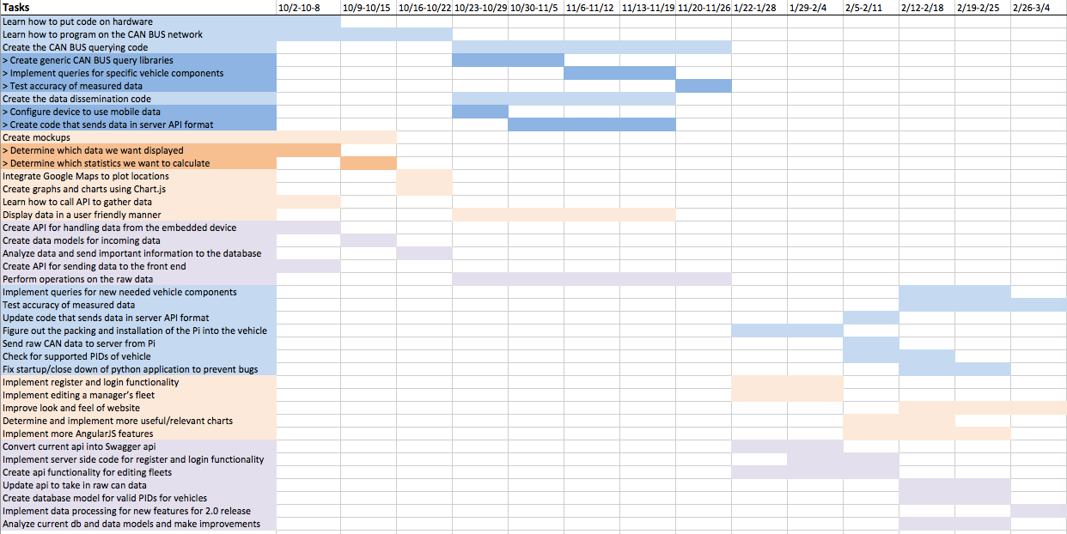
Project Schedule
Notes:
First semester- Split into 3 pairs(embedded,server,front end), lots of research, developed individually until the last few weeks we’ve integrated the three
Second semester- Tasks are set on the schedule, but Matt will go over our next steps in more detail later in the presentation

Slide 10
Detailed Design - Front End
User Interfaces: Emphasis on visualizing data
Technologies Used: AngularJS, Chart.js, Google Maps API, Bootstrap
Test Plan: UwAmp/XAmpp for local testing

Slide 11
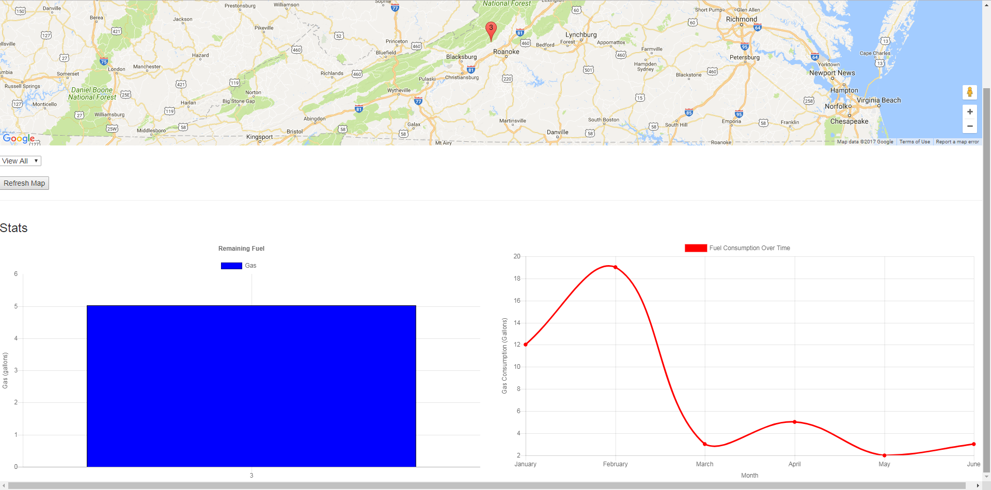

Slide 12
Detailed Design - Server
Technologies Used: NodeJS, MongoDB, Mongoose
Test Plan: Automated API Testing Using Postman, Unit Testing for Data Analysis
Hosted on Google Cloud Compute Engine
Swagger Documentation
Transitioning into a Swagger based API

Slide 13
Detailed Design - Microcontroller
Three Modules: gps_interface, can_interface, server_send
Technologies Used: Python, PiCAN2, Adafruit Ultimate GPS, gpsd, PyCan, requests
Test Plan: unittest.py, verify with simulator, compare with car actuals

Slide 14
Current Project Status
Prototypes for Python application, server, and front-end completed with interoperability.

Slide 15
Group Contributions
Venecia: Client side, emphasis on Google Maps API and AngularJS
Kendall: Client side, emphasis on Chart.js
Matthew: Android application for OBD-II, GPS, sending data. Attempted to fix Android hardware.
William: Android, Python, and ODB-II
Anthony:
Tyler:

Slide 16
Plan for Next Semester
Expand functionality for server and front-end.
Move to real vehicle use for Raspberry Pi.
Increase PID support for Python application.

